Slide 1
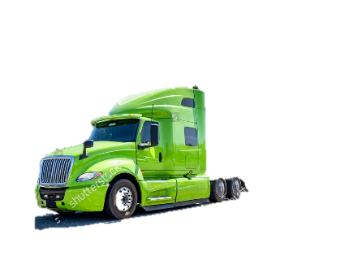

Xpt / lp risk

Slide 2
CARRIERs
Accredited Specialty Insurance Co
Lloyds of London
Star

Slide 3
Tipos de negocio
Flatbed
Cars (SOLO ES AL)
Dry van
Reffer
Frac sand
LOWBOY -Siempre y cuando NO haya cargas sobredimensionadas, sobrepeso, sobrealtura o sobrelongitud, podemos cotizar con estas.

Slide 4
Radio de operación
Intrastate & interstate
AL,AZ,FL,GA,IL,IN,IA,KS,MS,MO,NC,NE,OH,OK,SC,TN,TX,WI

Slide 5
Drivers / unidades
21 YEARS - Sometimes I can get them approved, if they are not driving. It is something that has to be submitted to Trisura to find out. They will definitely not approve, if the owner has a CDL.

Slide 6
Coberturas
LIABILITY
CARGO
PHYSICAL DAMAGE
GENERAL LIABILITY
WORKERS COMP

Slide 7
additional & wos
No cuesta

Slide 8
Contactos via email

